Slide 1
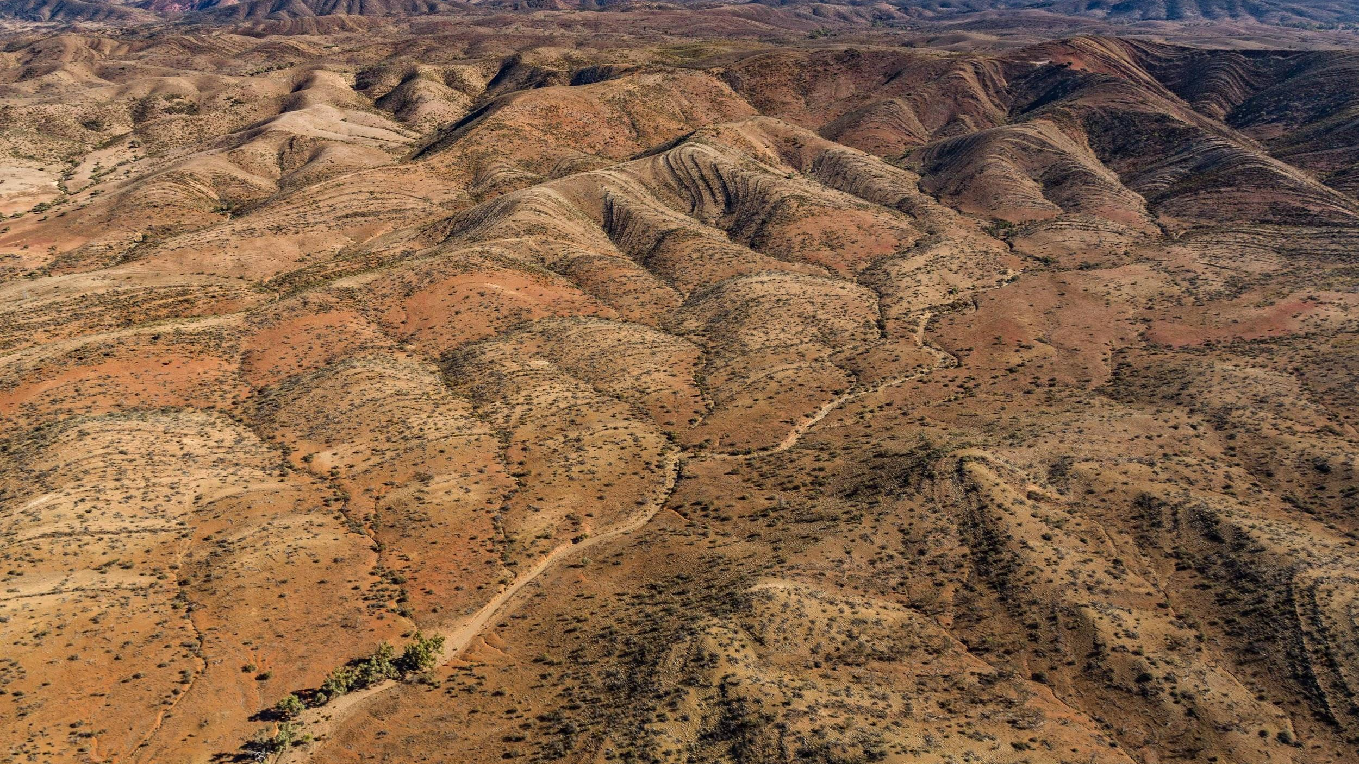
ABORIGINAL WATERWAY MANAGEMENT
We will explain how Aboriginal and Torres Strait Islander knowledge is applied to the care of waterways.
Notes:
Insert cover image and use transparency settings to fade image.

Slide 2
Do not delete this slide.
This slide is designed so that you can copy the prompt box you need and insert it into your slides.
This slide is hidden and will not be included when presenting your lesson.
TRACK WITH ME
VOCABULARY
1 -
HINT
Students, remember….
CHECK FOR UNDERSTANDING
READ WITH ME
TEACHER CUE
MAKE THE CONNECTION
Students, you already know….
EXTENSION
GESTURE WITH ME

Slide 3

Using the picture:
What are 2 observations?
What is one inference?

Slide 4
Repeat the opposite word/phrase.
MOON PHASE
SHAPE OF MOON SEEN

Slide 5
Repeat the opposite word/phrase.
ECLIPSE
BLOCKING OF LIGHT

Slide 6
Repeat the opposite word/phrase.
RENEWABLE RESOURCE
IT WILL NOT RUN OUT

Slide 7
Repeat the opposite word/phrase.
NON-RENEWABLE RESOURCE
IT WILL RUN OUT

Slide 8
Repeat the opposite word/phrase.
TRANSPIRATION
WATER LOST BY PLANTS

Slide 9
Repeat the opposite word/phrase.
EVAPORATION
HEATED LIQUID TURNS INTO GAS

Slide 10
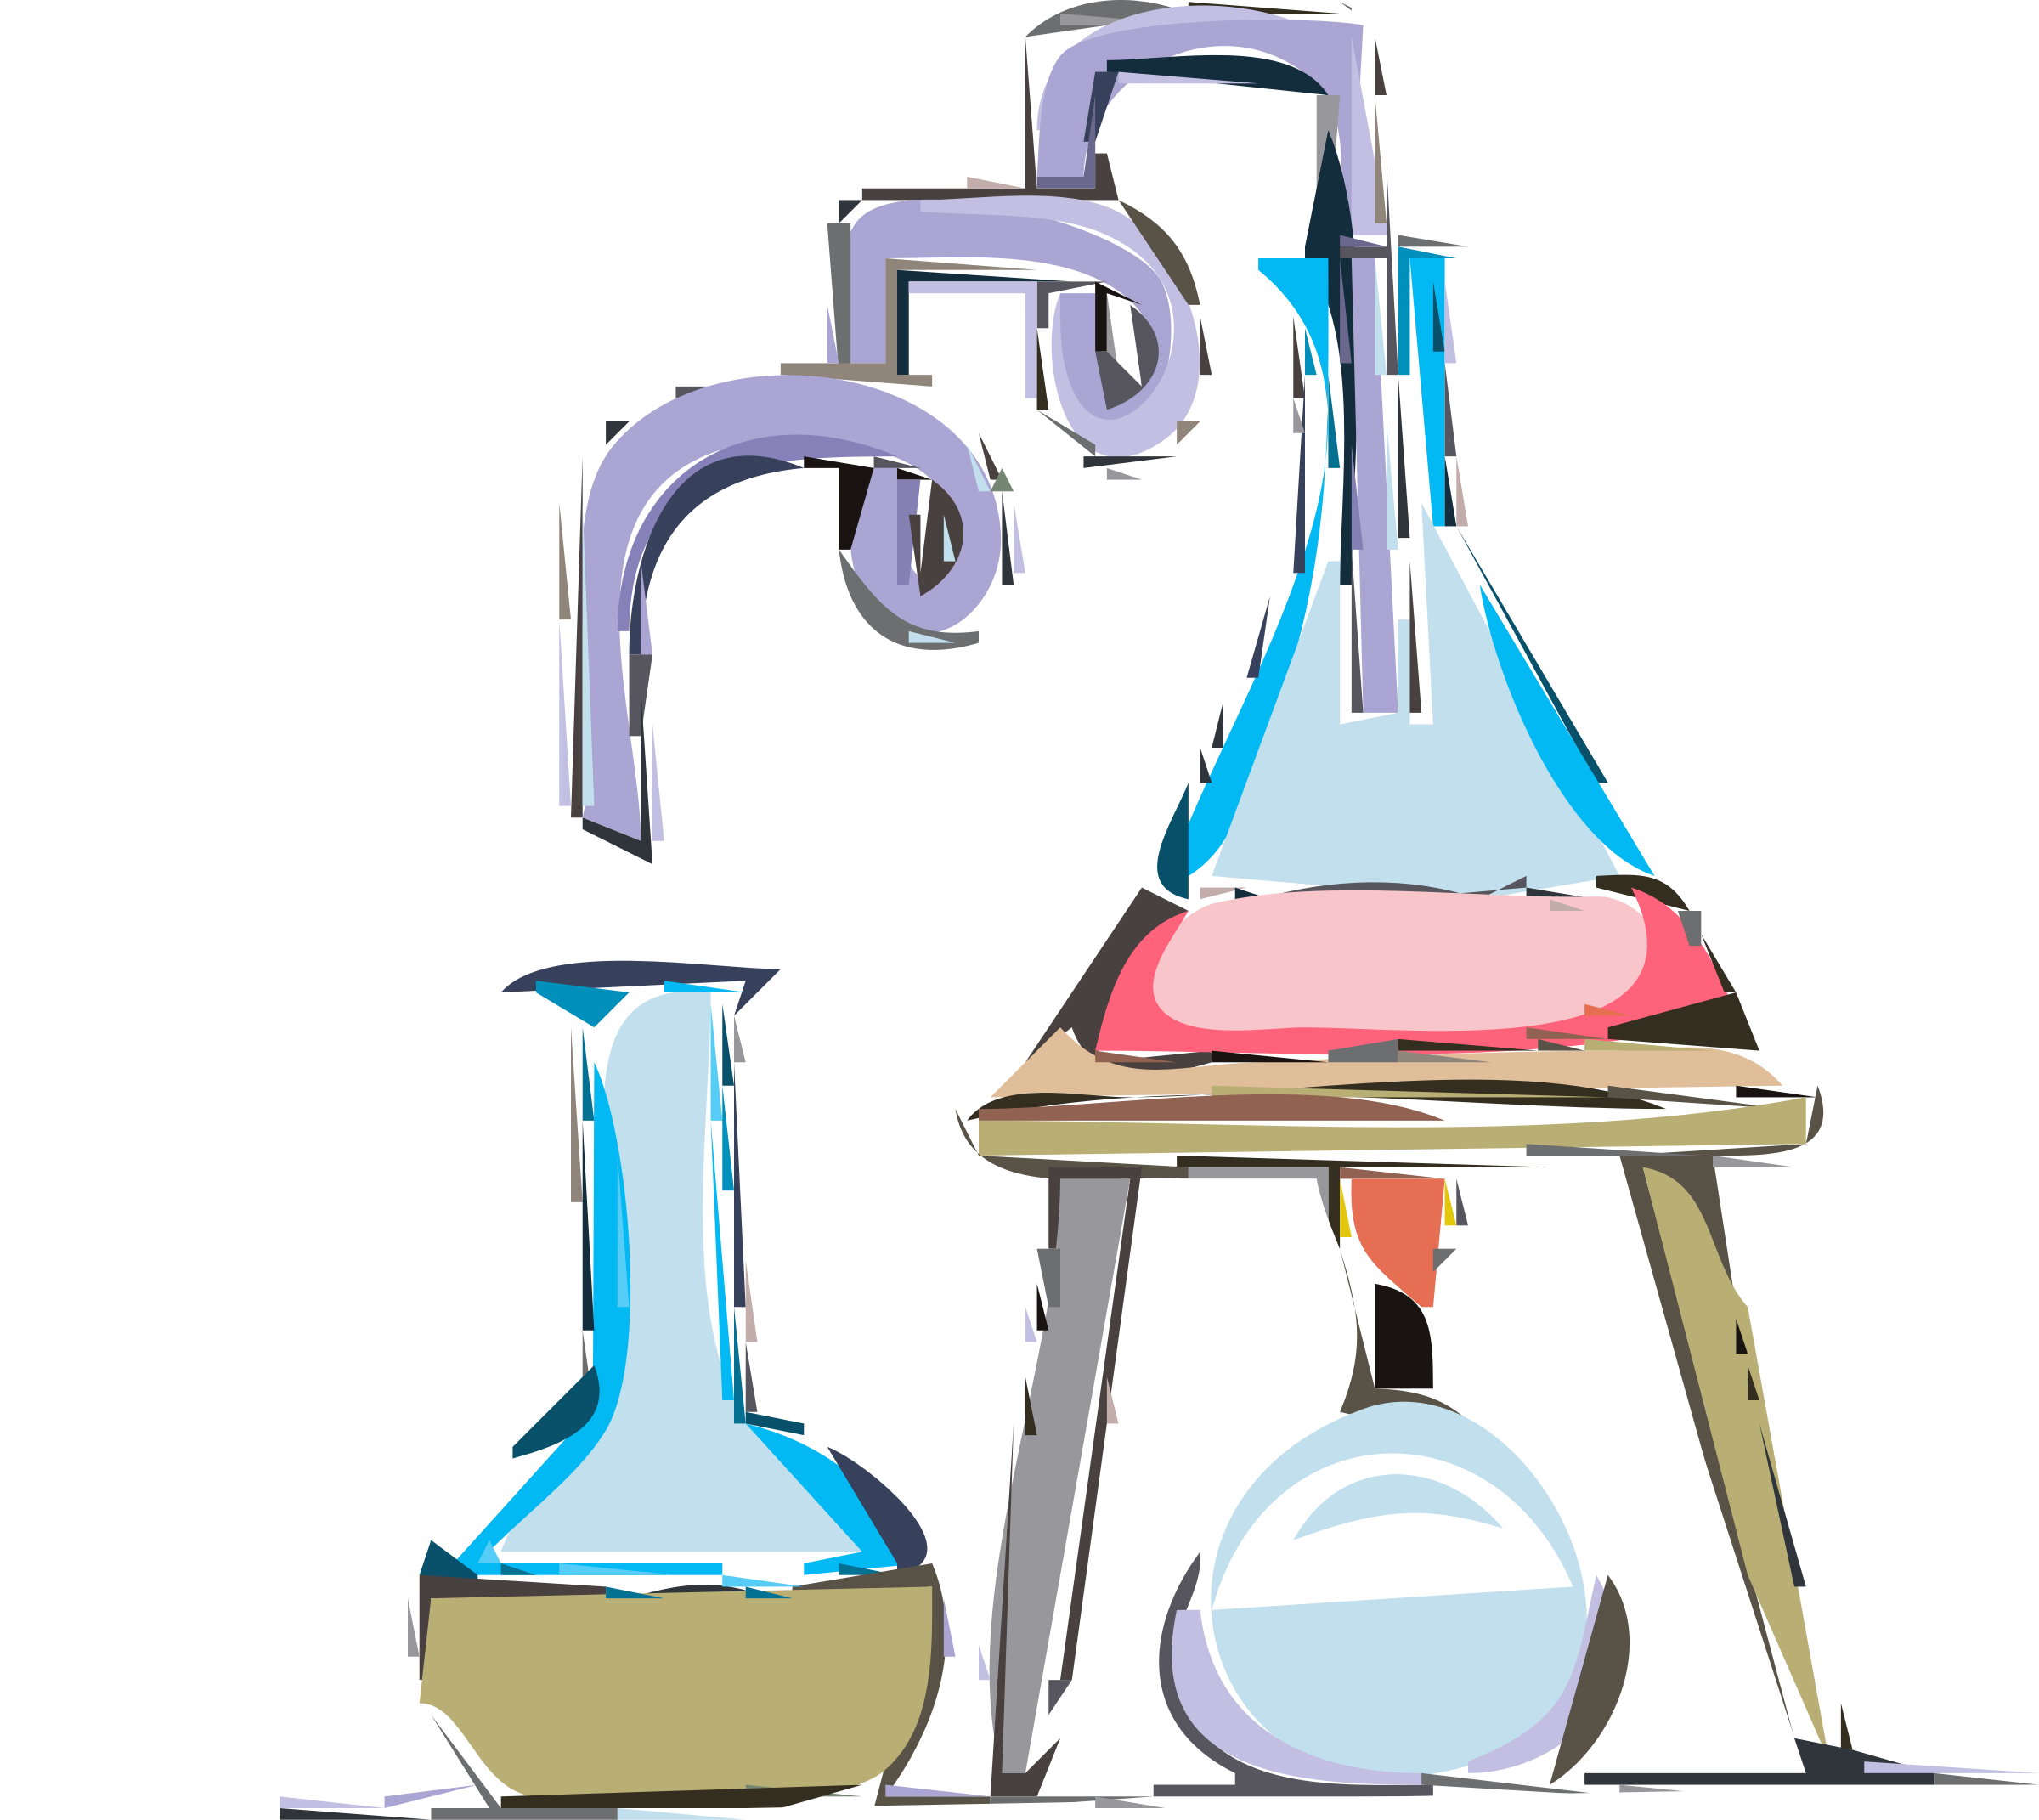
Sort the safety rules into either DO or DO NOT using the the table below:
run in the laboratory
leave a tidy desk
follow instructions
wear safety glasses for experiments
tell the teacher if you hurt yourself
DO | DO NOT

Slide 11
We will explain how Aboriginal and Torres Strait Islander knowledge is applied to the care of waterways.
TRACK WITH ME
READ WITH ME
We will discuss Aboriginal and Torres Strait Islander knowledge of waterways.
We will use examples of these knowledges being applied to the care of waterways.
DECLARE THE OBJECTIVE
Read the learning objective to your partner.
Notes:
Learning Objectives contain concepts (nouns, big ideas), skills (verbs, measurable behaviours) and sometimes context (restricting or targeting conditions).
●Example: Students will be able to describe the concept of density and apply it to floating and sinking.
●
Success criteria are specific measurable outcomes that if met mean that the student has met the learning objective.
Examples:
•Students will be able to compare densities of substances using mass and volume.
•Students will be able to identify whether a solid or liquid will float or sink in a liquid based on their densities.

Slide 12
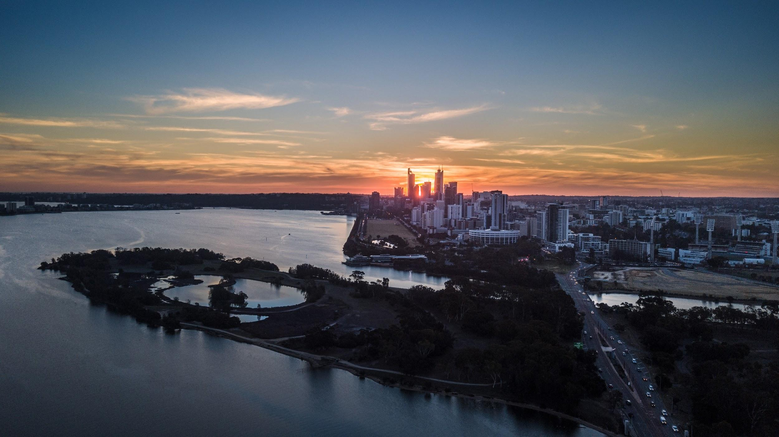
We will explain how Aboriginal and Torres Strait Islander knowledge is applied to the care of waterways.
The Swan River is referred to by the Noongar people as Derbarl Yerrigan. It is culturally significant to Noongar people, and non-Indigenous people and there is an expectation that it will be protected now and into the future.
CHECK FOR UNDERSTANDING
Do you think anyone is responsible for protecting and managing the Swan River? Who?
Notes:
The Swan River Trust is the government organisation responsible for the protection of the Swan and Canning Rivers

Slide 13
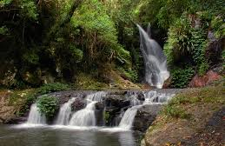
We will explain how Aboriginal and Torres Strait Islander knowledge is applied to the care of waterways.
CHECK FOR UNDERSTANDING
What is unique about the knowledge of water in different Indigenous cultural groups?
Water is an essential aspect of the beliefs, practices and cultures of Aboriginal and Torres Strait Islander peoples.
Indigenous people have long-held cultural and traditional responsibilities to protect and manage their land and sea country.
Indigenous Australians manage or jointly manage 11 of the 65 Australian wetlands recognised as internationally important.

Slide 14
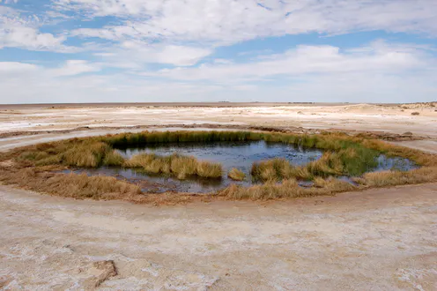
We will explain how Aboriginal and Torres Strait Islander knowledge is applied to the care of waterways.
Indigenous country includes the land, water, sea and sky and the connections between them.
The value placed on connectedness enables landscapes to be managed at an ecosystem₁ or habitat₂ level.
The Australian, state and territory governments collaborate with Indigenous people to develop ways to enhance Indigenous land and sea management.
CHECK FOR UNDERSTANDING
Why is water important to Aboriginal and Torres Strait Islander people?
VOCABULARY
1 - living community in a physical environment 2 - home of a living thing

Slide 15
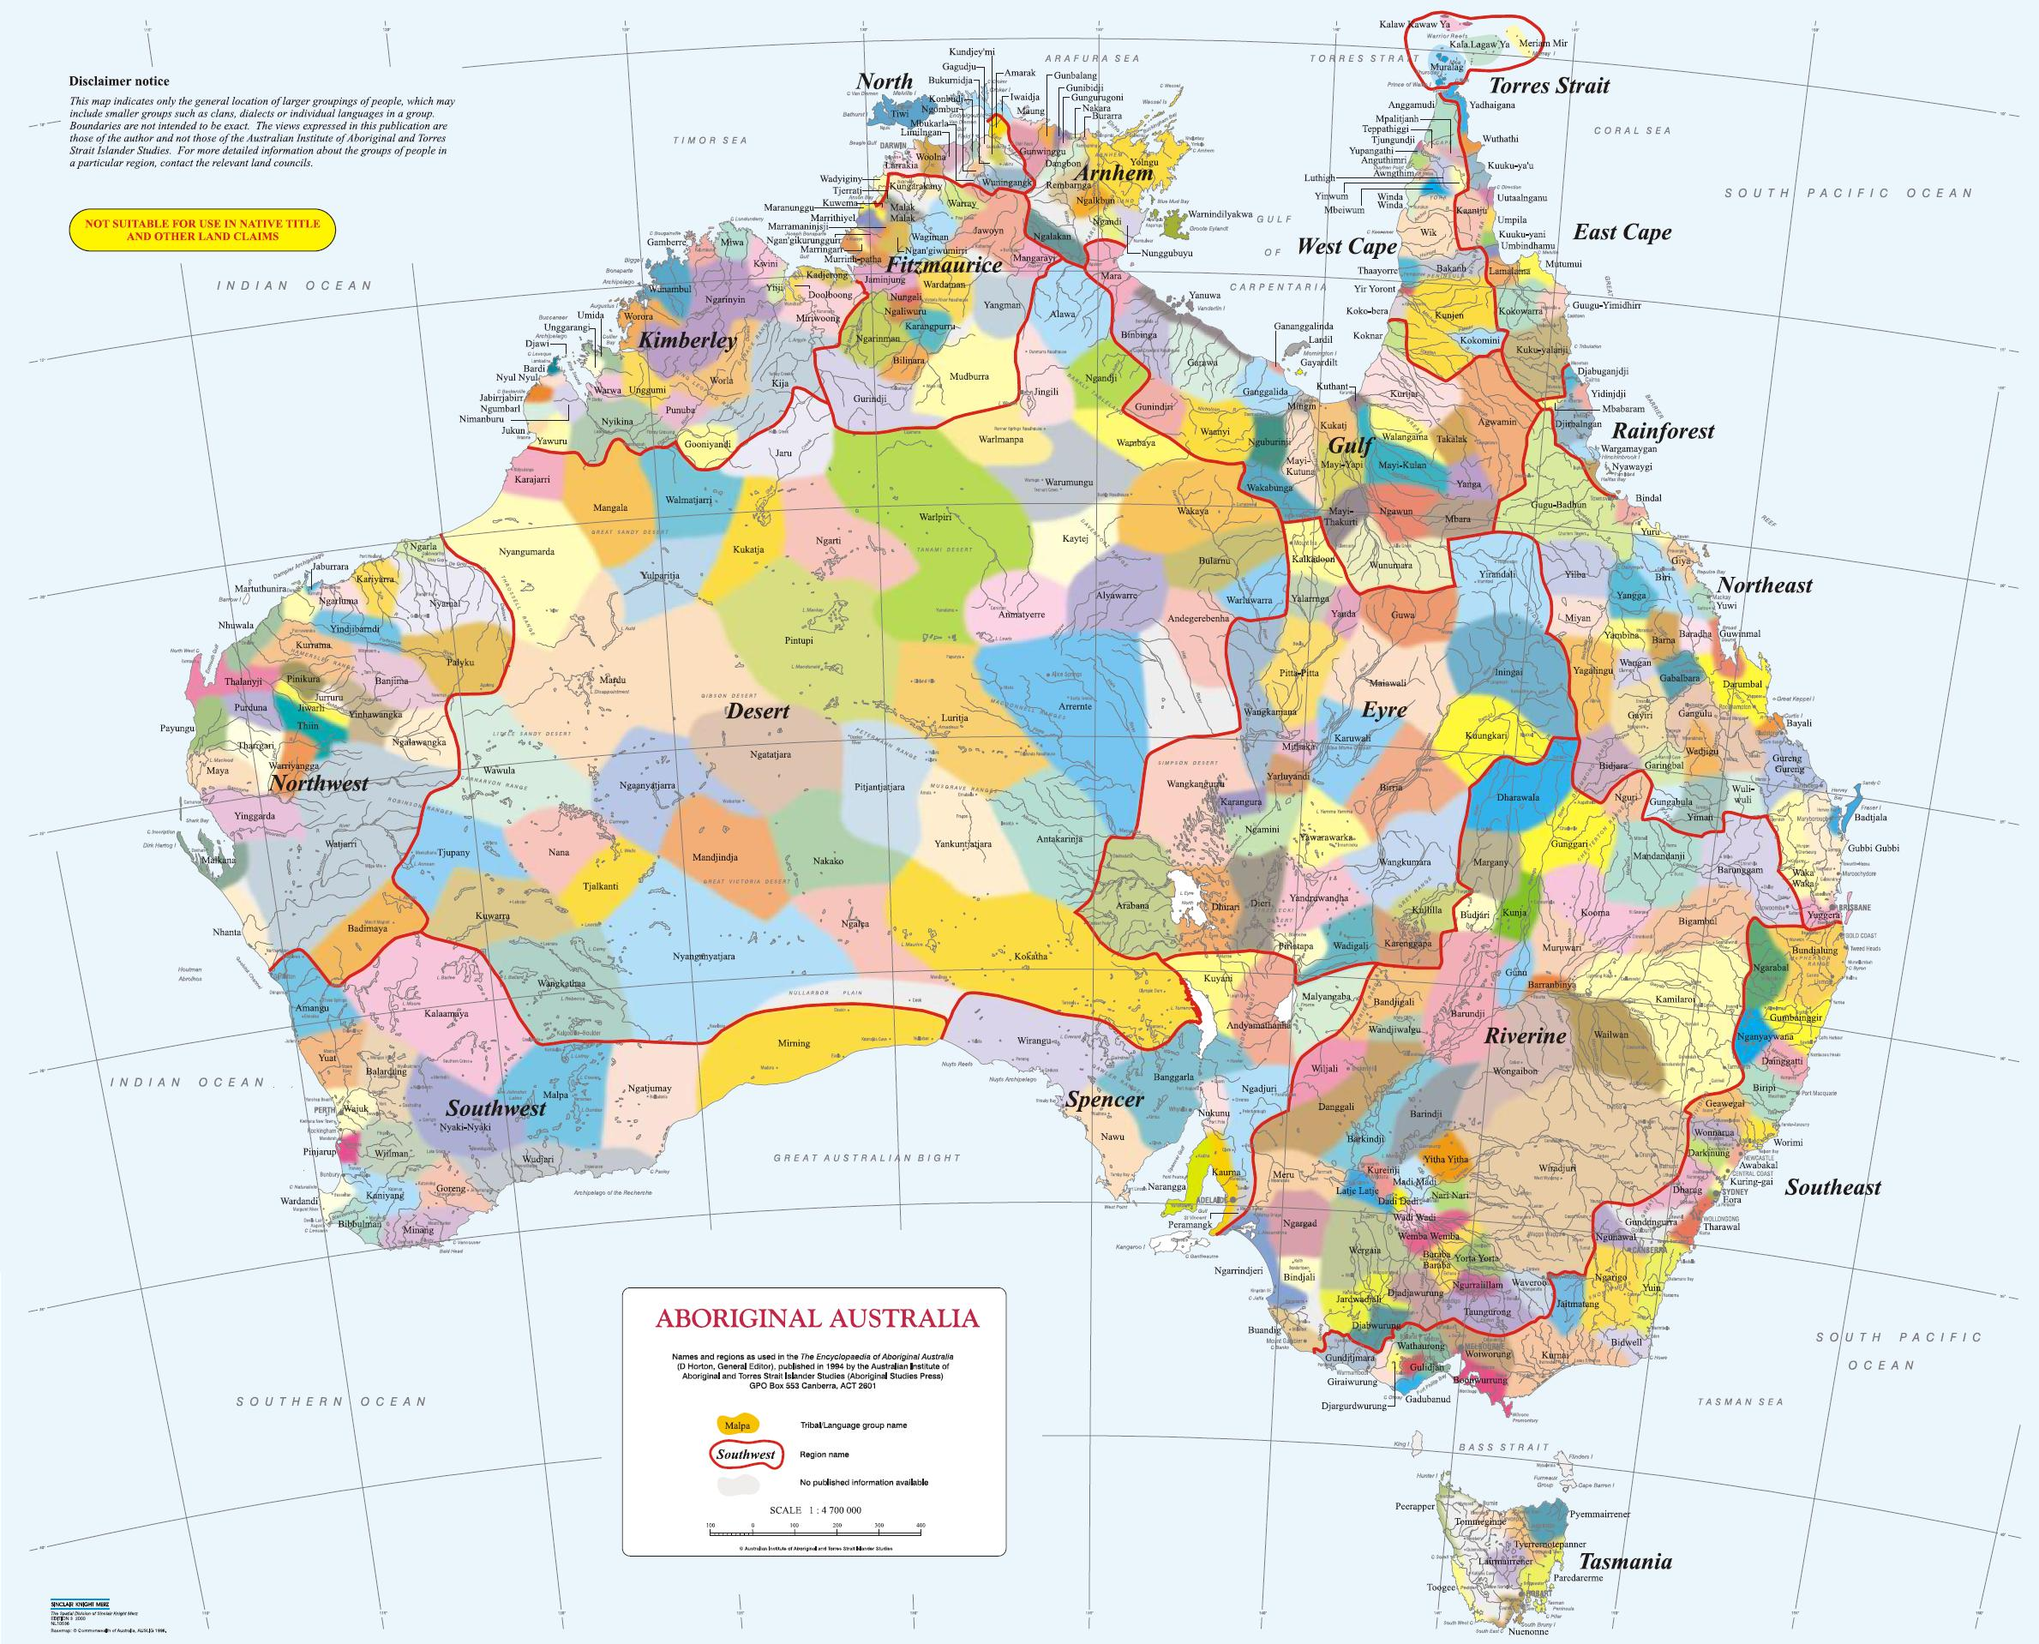
We will explain how Aboriginal and Torres Strait Islander knowledge is applied to the care of waterways.
In the Kimberley region of Western Australia, the Nyul Nyul people have a strong association with fresh water sources on their traditional land.
The Nyul Nyul Rangers are protecting the wetlands in ‘the right way’, managing fire, feral animals and weeds under the Working on Country programme with the Kimberley Land Council.

Slide 16
We will explain how Aboriginal and Torres Strait Islander knowledge is applied to the care of waterways.
Some local governments and scientific organisations are working with Aboriginal and Torres Strait Islander cultural groups to help manage water way health.
They use their knowledge of plants and animals in areas to monitor ecosystem₁ health and the appropriate level of water usage.
There is still a need for more cross-cultural collaborative management of waterways.
CHECK FOR UNDERSTANDING
What Indigenous knowledge is being used to manage water ways?
VOCABULARY
1 - living community of interacting organisms and their environment

Slide 17
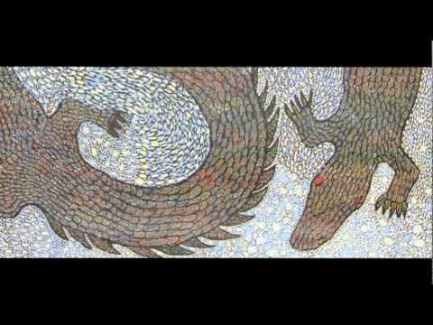
CHECK FOR UNDERSTANDING
1:00 - How is Aboriginal knowledge often passed on? 2:00 - Why are rivers, creeks and billabongs important to Indigenous people? 5:55 - How do people know its a good time for freshwater prawns and barramundi? 7:00- What are some of the foods collected from waterways? End - How is Aboriginal knowledge used in waterway planning?
We will explain how Aboriginal and Torres Strait Islander knowledge is applied to the care of waterways.
Aboriginal water values and management in northern Australia
TEACHER CUE
Pause at time cues for students to answer questions.

Slide 18
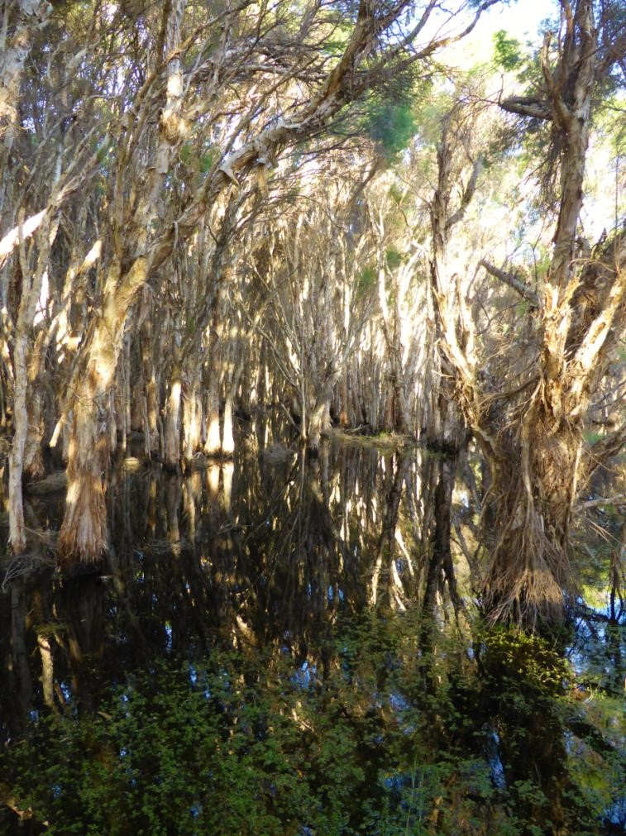
We will explain how Aboriginal and Torres Strait Islander knowledge is applied to the care of waterways.
Ellen Brook has the largest catchment area of all the Swan-Canning subcatchments on the Swan Coastal Plain. It discharges into the upper Swan Estuary near West Swan Road in Belhus.
The Ellenbrook catchment area contributes the highest nutrient levels out of the 14 Swan-Canning catchments with data. These nutrients make their way into waterways from animal wastes and fertilisers used for agriculture and home gardens.
Better management of water in this catchment is necessary in the future.
CHECK FOR UNDERSTANDING
What do you think the consequences are of high nutrient levels entering rivers and wetlands?

Slide 19
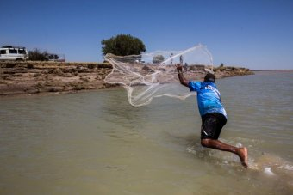
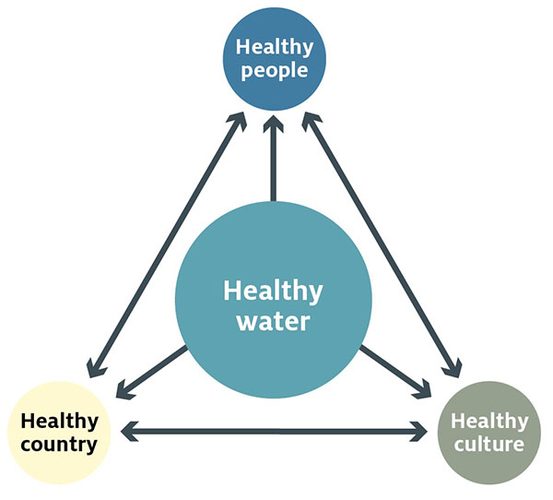
We will explain how Aboriginal and Torres Strait Islander knowledge is applied to the care of waterways.
Indigenous people value waterways because:
they provide bush foods and medicines
are part of a culturally significant landscape
have the potential to sustain future water-related businesses and employment.
More consultation between Indigenous and non-Indigenous people is necessary in the future to ensure the best possible management of environmental assets such as the Swan-Canning River.

Slide 20
We will explain how Aboriginal and Torres Strait Islander knowledge is applied to the care of waterways.
Describe Aboriginal and Torres Strait Islander knowledge about water and care of waterways.
Write at least three sentences.
Use the following words to help you:
Aboriginal and Torres Strait Islander peoples
Water
Environment
Care
Plants
Animals
Notes:
Please include tasks/questions here rather than just referring to a worksheet. This will save on photocopying and facilitate sharing with other schools.
Try and build tasks/questions which escalate through Bloom’s Taxonomy. This will help with differentiation.

Slide 21
We will explain how Aboriginal and Torres Strait Islander knowledge is applied to the care of waterways.
We will discuss Aboriginal and Torres Strait Islander knowledge of waterways.
We will use examples of these knowledges being applied to the care of waterways.
CHECK FOR UNDERSTANDING
Check Success Criteria.

Slide 22
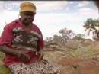
We will explain how Aboriginal and Torres Strait Islander knowledge is applied to the care of waterways.
Finding Water in the Desert - Ray Mears World of Survival - BBC
CHECK FOR UNDERSTANDING
What is one way that Aboriginal people find water in the desert?
Aboriginal and Torres Strait Islander locate water above and below the ground by reading the landscape, and following cues from plants and animals to find water.

Slide 23
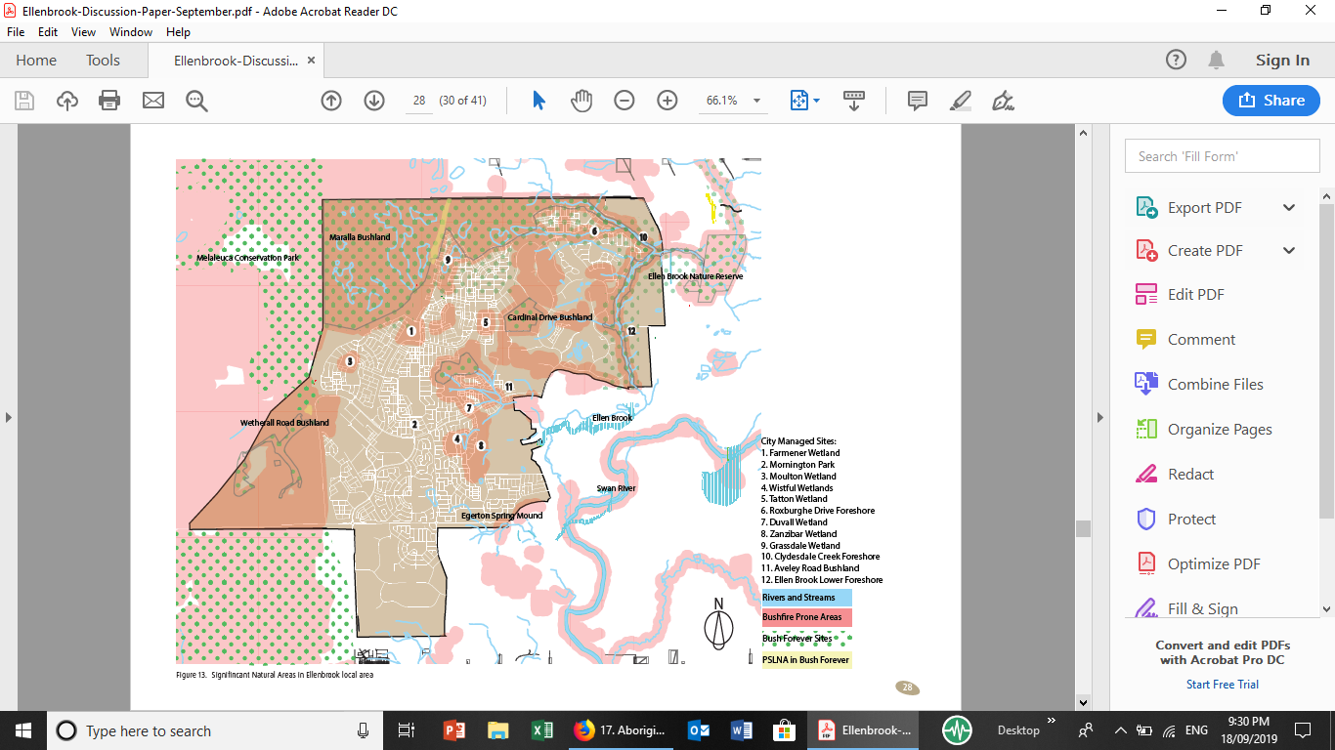
We will explain how Aboriginal and Torres Strait Islander knowledge is applied to the care of waterways.
Aveley Secondary College

Slide 24
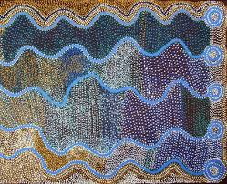
We will explain how Aboriginal and Torres Strait Islander knowledge is applied to the care of waterways.
Aboriginal peoples’ value of water is sacred, deep and necessary for survival. It is protected by Lore₁, which provides a system of sustainable management.
Dreaming stories across Australia show the spiritual connection between Aboriginal people and water sources. These stories highlight the role of spirits in creating sources of water, and the ongoing supply and control of these watercourses by ancestral spirits and creation beings.
Of special significance are the stories of the serpent-like creatures who created many rivers and wetlands. In the south west this creature is called Waugal, in the Gascoyne/Murchison Beemarra, in the Pilbara Warlu and parts of the Western Desert Wompi.
CHECK FOR UNDERSTANDING
How is knowledge passed on between generations?
VOCABULARY
1 - customs and stories passed on through the generations through songs, stories and dance

Slide 25
We will explain how Aboriginal and Torres Strait Islander knowledge is applied to the care of waterways.
Task
Task
CHECK FOR UNDERSTANDING
The Ellenbrook local area is adjacent to the critically endangered Western Swamp Tortoises, which were thought to be extinct before their rediscovery in 1953. They are currently being bred at the Perth Zoo and being released in several sites including the Ellen Brook Nature Reserve and Twin Swamps Nature Reserve.
The Ellenbrook local area contains many Bush Forever sites within and around its boundary. These sites include Egerton Spring Mound, which is under the control of the WAPC, and Cardinal Drive Bushland, Wetherall Road Bushland (1&2), Maralla Road Bushland and Melaleuca Conservation Park, which are under the control of the Department of Parks and Wildlife.
HINT
Students, remember….
VOCABULARY
Notes:
Please include tasks/questions here rather than just referring to a worksheet. This will save on photocopying and facilitate sharing with other schools.
Try and build tasks/questions which escalate through Bloom’s Taxonomy. This will help with differentiation.

